Slide 1
Dominos - Predictive Purchase Order System
GOODWIN BLESSO I
MDT - 38

Slide 2
Introduction
Problem Statement:
Domino’s wants to optimize ingredient ordering by predicting future sales.
Accurate sales forecasting helps ensure the right stock levels, minimizing waste and preventing stockouts.
Objective:
Develop a predictive model using historical sales data and ingredient requirements.
Generate an efficient purchase order system based on future sales.
Benefits:
Maintain optimal stock levels to meet demand without overstocking.
Minimize waste and reduce costs from expired or excess inventory.
Predict sales trends to improve business strategies and streamline ingredient ordering based on predicted sales.

Slide 3
Overview
Dataset:
Data Source: Historical sales data of Domino’s
Features: The time component order_date serves as the feature variable (time-series forecasting).
Target: The quantity serves as the target variable.
Dataset Size: 2,67,576 records
Data Preprocessing:
Merge Dataset: Merged both the datasets Sales and Ingredients into a single data frame.
Missing Value Treatment: Check for missing values in the df and treated.
The missing values in the column are handled using a mapping approach.
Data Type Conversion: Converted the order_date to datetime format.
Librabries Used:
Pandas
Scikit-learn
Missingno
Matplotlib
Seaborn

Slide 4
Feature Engineering:
Identified Promotional Periods
Captured Holiday Effects
EDA:
It involves analyzing and visualizing data to understand its structure, detect patterns, and identify anomalies.
Insights:
Consistent Monthly Sales:
Pizza sales are evenly distributed across all months, indicating stable demand throughout the year.
Peak Sales on Fridays:
Sales volume spikes on Fridays, suggesting higher demand at the start of the weekend.
Popular Pizza Size:
Large ("L") pizzas have the highest sales, indicating a customer preference for bigger portions.
Top Revenue Generator:
Chicken pizzas contribute the most to total revenue, making them the most profitable category.
Most Sold Pizza Type:
Veggie pizzas lead in terms of quantity sold, reflecting strong customer preference.
Higher Sales on Non-Holiday Days:
More pizzas are sold on regular days compared to holidays.

Slide 5
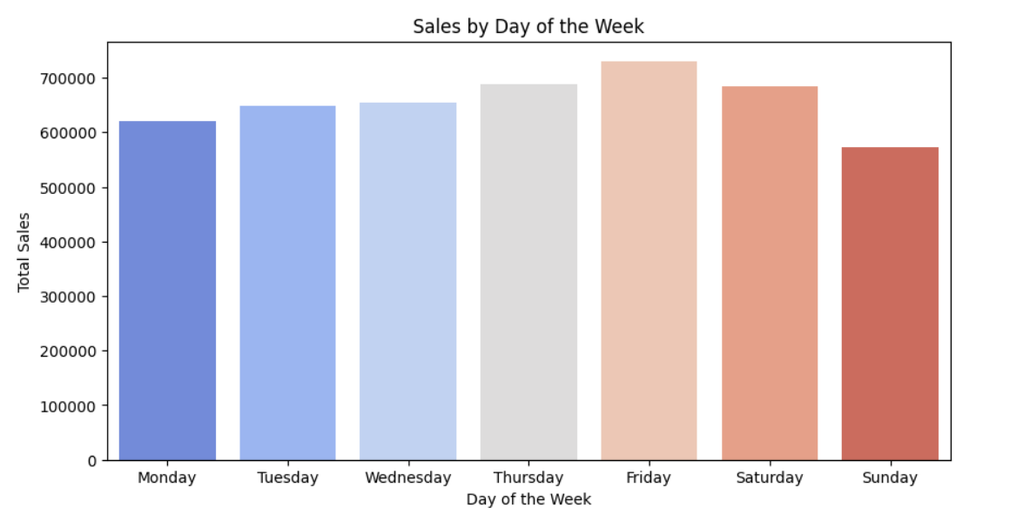
Charts:

Slide 6
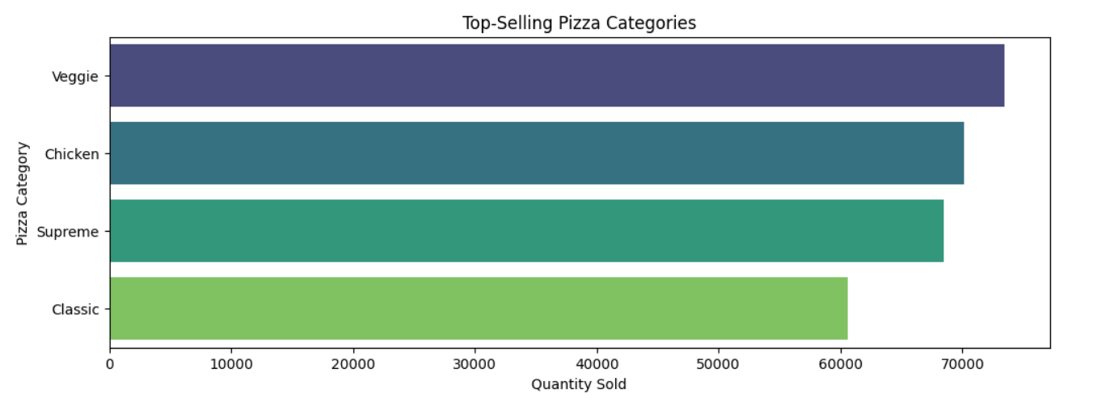

Slide 7
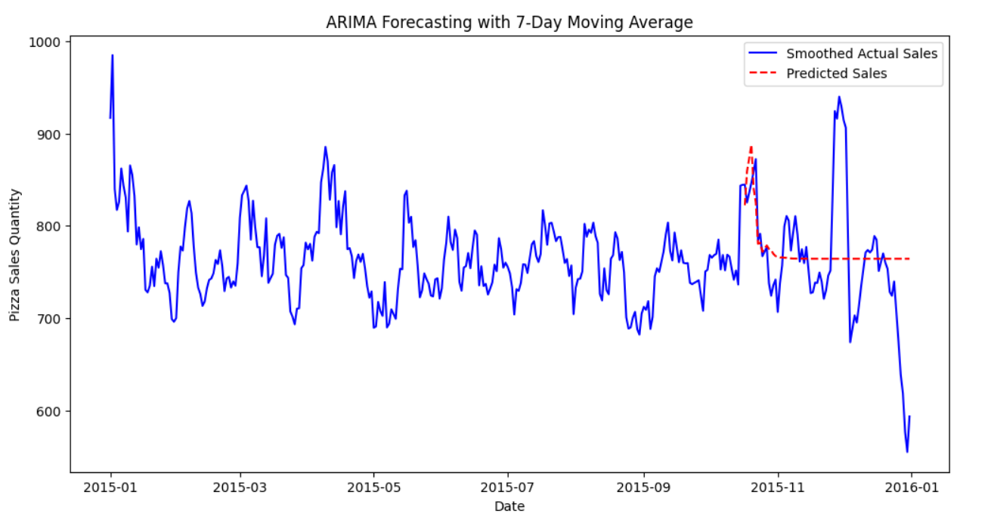
Model Development:
Data split: train_test split (Training: 80%, Testing: 20%).
Algorithm Used: ARIMA (AutoRegressive Integrated Moving Average) is chosen for this time series forecasting project because it effectively captures trends, non-seasonality, and patterns in historical sales data.
Model Evaluation:
Metrics: Mean Absolute Percentage Error (MAPE)
Score: 6.65%

Slide 8
Predicted Pizza Sales for Next 7 Days:
S.No | Date | Predicted Quantity
1. | 01-01-2016 | 822.26
2. | 02-01-2016 | 859.03
3. | 03-01-2016 | 887.93
4. | 04-01-2016 | 840.79
5. | 05-01-2016 | 825.02
6. | 06-01-2016 | 780.51
7. | 07-01-2016 | 781.58

Slide 9
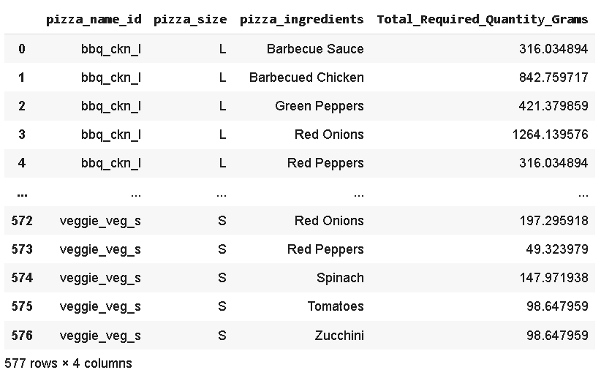
Ingredient Calculation:

Slide 10
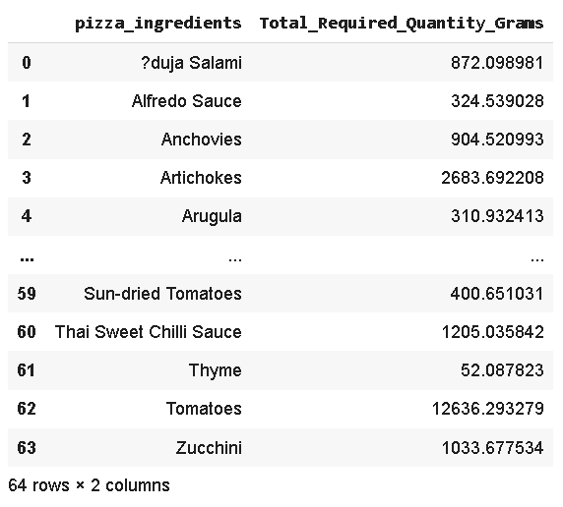
Purchase Order Creation:

Slide 11
Recommendations
Data-Driven Inventory Management:
Optimize ingredient ordering based on predicted sales to prevent overstocking or stock outs.
Focus on high-demand ingredients (e.g., Tomatoes, Artichokes, Mozzarella) to ensure seamless operations.
Customer Experience Enhancement:
Ensure consistent availability of popular pizzas (e.g., Chicken pizzas, Veg pizzas).
Use sales forecasts to improve delivery efficiency, ensuring faster service during peak periods.
Profitability Optimization:
Bundle popular pizzas with slow-moving ones to balance inventory usage.
Reduce ingredient waste by adjusting procurement cycles based on predicted demand.
Conclusion
ARIMA model predicted the pizza sales and ingredients required for that very accurately.
Helps Domino’s optimize inventory and reduce waste.

Slide 12
Thank You

